Slide 1


Phishing Awareness: Don’t Get Hooked!
A Cyber Security Internship Project by Sai Tarun
Presented for: CodeAlpha Internship Program

Slide 2
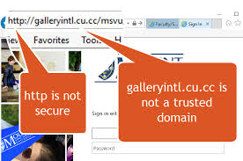
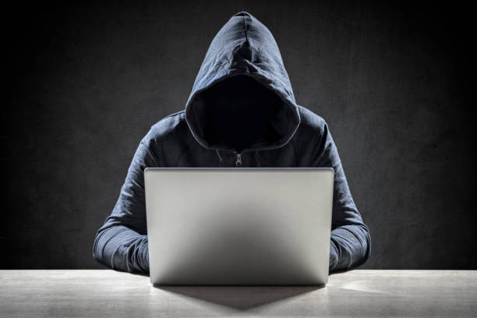
What is Phishing?
Phishing is a deceptive attempt to trick individuals into revealing personal or financial information through fake communication, often via email, SMS, or websites.
Mimics trusted brands or people.
Creates urgency or fear.
A leading cause of data breaches.

Slide 3
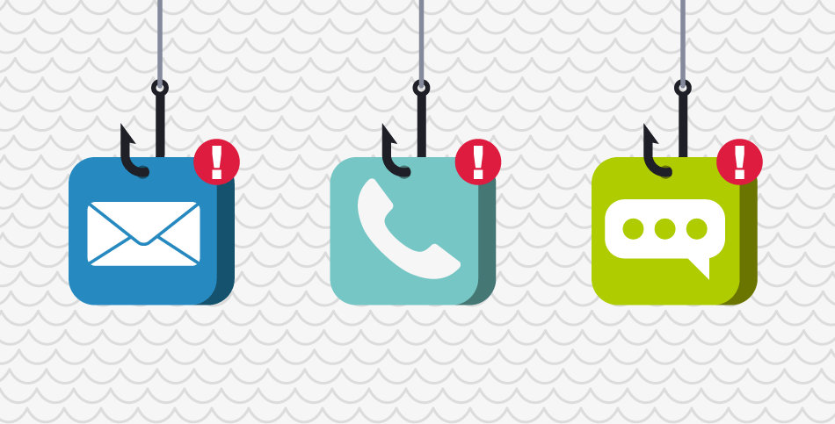
Types of Phishing Attacks
Email Phishing: Mass emails pretending to be from trusted services.
Spear Phishing: Personalized attacks on individuals.
Whaling: Targeting top executives.
Smishing: Phishing via SMS.
Vishing: Voice-based phishing (fake calls).

Slide 4
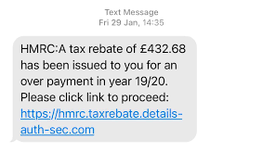
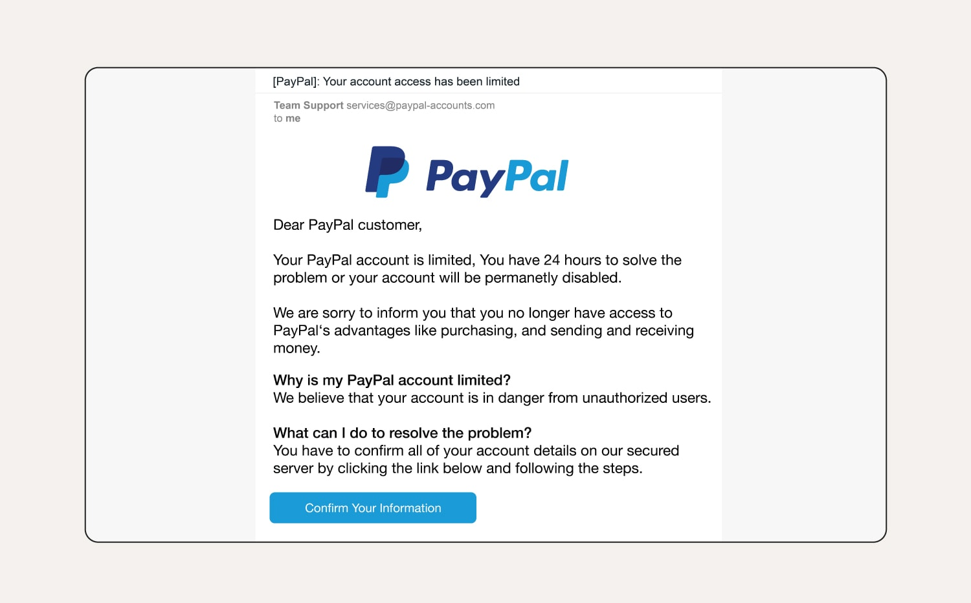
Real-World Examples
A fake PayPal email with “Click here to secure your account”.
A cloned bank login page.
A fake job offer email.

Slide 5
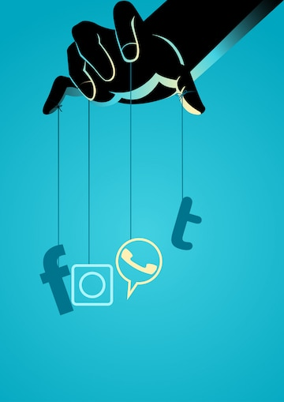
Social Engineering Tactics
Phishing works by manipulating human behavior, not just technology.
Common tactics:
Fear/Urgency: "Account blocked!"
Reward: "You’ve won a voucher!"
Authority: "From your bank CEO"
Curiosity: "See who viewed your profile"

Slide 6
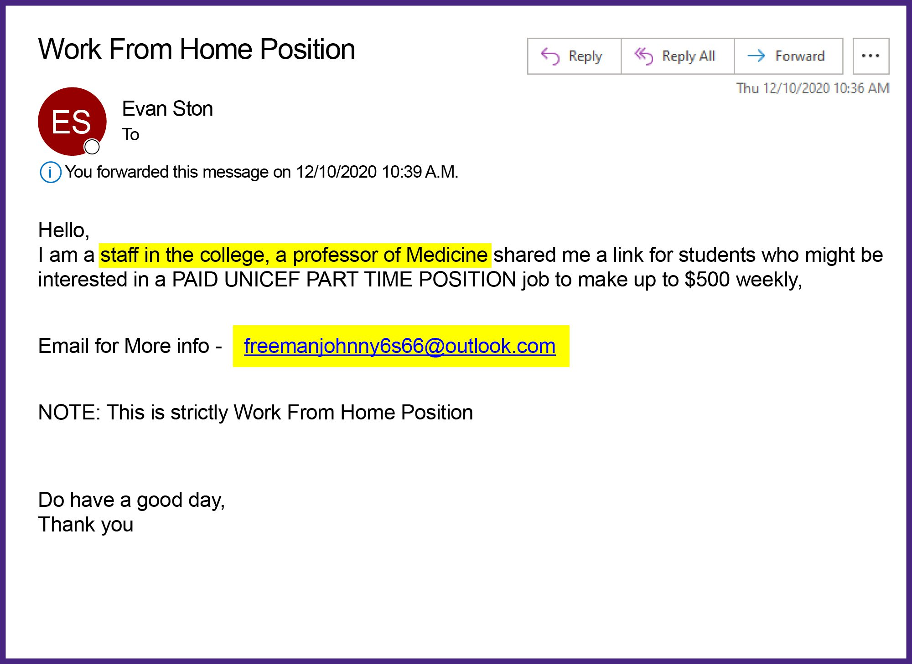
How to Recognize Phishing
Red Flags:
Spelling or grammar mistakes
Fake domains (e.g., amaz0n.com)
Unusual sender names
Attachment or suspicious links
Generic greetings (e.g., “Dear user”)

Slide 7

Best Practices to Avoid Phishing
Type URLs manually
Enable 2-Factor Authentication
Don’t open unknown attachments
Always verify sender
Report phishing attempts

Slide 8
Tools to Detect Phishing
Top Tools:
PhishTank – Real-time phishing database
VirusTotal – Scans URLs/files
Google Safe Browsing
WOT (Web of Trust)
Gmail/Outlook Spam Filters

Slide 9

Conclusion
Stay informed, stay cautious.
Think before you click!
Share knowledge with your friends/family.
Report phishing emails to protect your organization.
“Awareness is the first step in cybersecurity.”

Slide 10

References
Content:
https://www.phishing.org
https://www.cyber.gov.au
https://www.consumer.ftc.gov
Microsoft Security Intelligence Reports
Proofpoint 2023 Phishing Report

